Slide 1
New Member Pack Ireland Chapter of the PMI

Slide 2
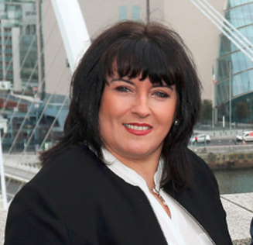
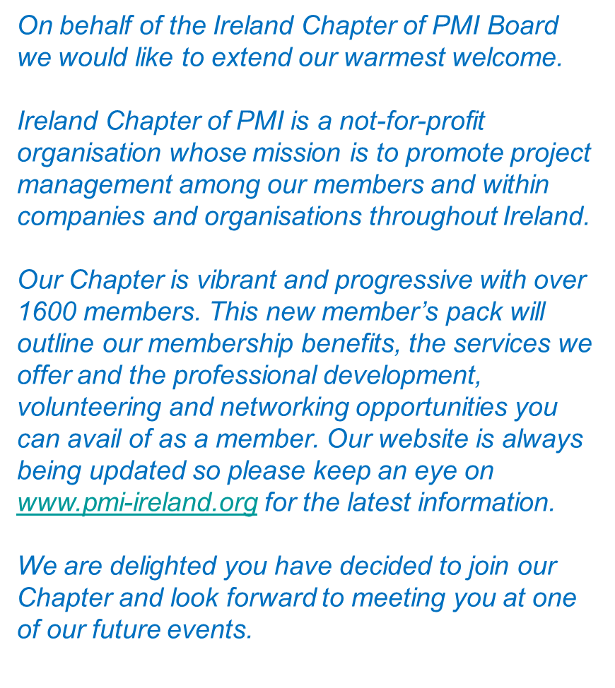
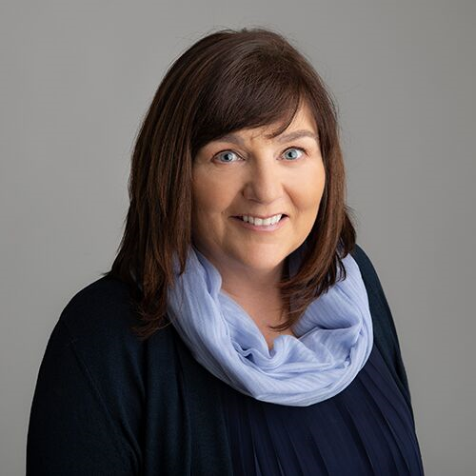

Slide 3
The newly created First Year Member video presentation will help you discover valuable paths to enhance your experience, build your network and leverage all that PMI offers.
Click here for video presentation link

Slide 4
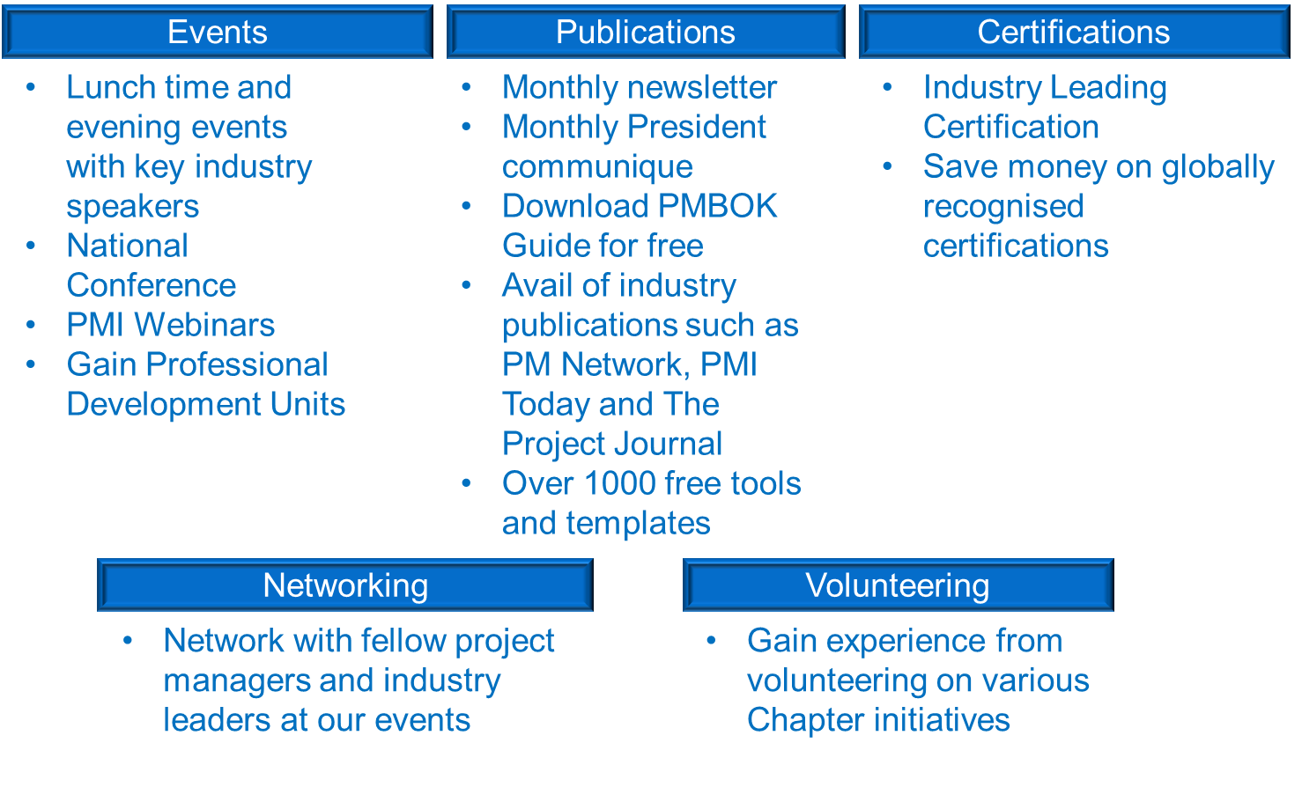

Slide 5
Jackie Glynn President jglynne@pmi-ireland.org | Jackie Fagan Vice President jfagan@pmi-ireland.org
Pat Lucey Past President plucey@pmi-ireland.org | Linda Romeri-McDermot Director of Finance lromeri-mcdermot@pmi-ireland.org
Clive Carroll Director of Membership ccarroll@pmi-ireland.org | Mike Schofield Director of technology mschofield@pmi-ireland.org
Ian Elliot Director of Sponsorship Ian.Elliot@pmi-ireland.org | Dermot Hore Director of Professional development dhore@pmi-ireland.org
Paul Gibson Director of Governance pgibson@pmi-ireland.org | Thomas McGrath Director of Volunteering tmcgrath@pmi-ireland.org
Helen Mahon Director of Academic Outreach hmahon@pmi-ireland.org | Katrina Collins Director of Events kcollins@pmi-ireland.org
Peter Glynn Director of Marketing pglynne@pmi-ireland.org | Ronan O’ Beirne National Conference Manager robeirne@pmi-ireland.org
Niamh Mongey Director of Communications nmongey@pmi-ireland.org | Louise McFadden Director of Administration louise.mcfadden@pmi-ireland.org

Slide 6
Ireland Chapter web site | https://www.pmi-ireland.org/
PMI Website | https://www.pmi.org/
LinkedIn | https://www.linkedin.com/company/765734/
Facebook | https://www.facebook.com/pmiireland/
Twitter | @pmiirl

